Slide 1
A NON-PROFIT ORGANIZATION
ZAYN EDUCATIONAL TRUST
http://www.sbs.ac.in/zayntrust

Slide 2
About Zayn Trust
Zayn Trust was established in 2004 by Dr M.A. Zahir and his son Dr Zafar Zahir
Objective is promotion of professional education, skill development, health for all that leads to a fulfilling life especially to the under-privileged sections of the society
A Non-Profit Trust registered with NITI AYOG, Government of India with members from across businesses and professionals of Punjab

Slide 3
Why we Exist?
To help underprivileged youth of our country to fulfil their dreams
Our Mission is to create an ecosystem that bring lasting changes in the community through empowered education

Slide 4
People Behind SBS
SBS has been established by renowned management expert and academician Dr. M.A. Zahir, Professor of Management & Dean (Retd.) PAU, Ludhiana as an autonomous institute, specializing in management education, executive training, research and consultancy. It is managed by an Educational Trust, namely Zayn Educational Trust established in Nov 2004.
SBS founding Board of Trustees consisted of a rich mix of academicians and industrial leaders from Punjab and abroad:
Dr. M.A. Zahir, Professor of Management & Dean (Retd), PAU, Ludhiana*
Mr.Rajinder Gupta, MD, Abhishek Industries Ltd (Trident Group)*
Mr.D.L Sharma, MBA, President & ED, Vardhman Textiles Ltd, Ludhiana*
Mr.Mann Singh, CMD, Metro Tyres Ltd, Ludhiana*
Mr.Sanjeev Pahwa, B.Tech, MBA, MD, Ralson India Ltd, Ludhiana*
Mr.S.K Rai, M.Tech, MD, Hero Cycles Ltd., Ludhiana
Mr.Amjad Ali, MBA, MD, Sohrab Group of Industries, Malerkotla*
Mr.D.V. Jindal, Professor English (Retd), Government College, Ludhiana*
Dr. Narendra K. Rastagi, Chair & Professor, Howard University, USA.
Mr. Nirmal Jain, CA, M D, Neva Garments Ltd (Duke Group), Ludhiana
Mr. Mahesh Munjal, MBA, MD, Majestic Auto Ltd., Ludhiana
Dr. Dinesh Sharma, Ph.D, Associate Professor, UMES, Maryland, USA.
Dr. Deepak Sood, Professor, Faculty of Management, HP University, Shimla.
Dr Kamal Nayan, MBA, Ph.D, Professor, Howard University, Washington DC, USA
Dr. Zafar Zahir, MBA, Ph.D, Director Strategy, Saudi Telecom, Riyadh, Saudi Arabia*
5

Slide 5
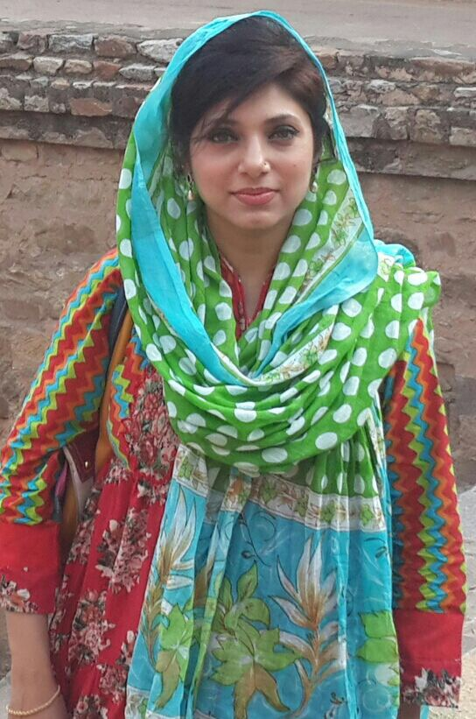
Managing Trustees Profile
Dr Ghazala Qadri, Chairperson
Dr. Ghazala currently serves as Chairperson of Zayn Educational Trust – a non-profit Trust/Society – that manages Synetic Business School (SBS) and SIMTA for vocational training in education and work for health and well-being in Semi-Urban and Rural Areas of Punjab. She got fellowship in Dietetics and Nutrition from Appollo Medversity, Hyderabad, India in 2012 and Certificate course in Panchkarma from DAV Ayurveda College, Jalandhar, India in 2015. She completed Bachelor in Unani Medicine & Surgery (BUMS) from Jamia Hamdard (Hamdard University), New Delhi, India in 1998.She has more than ten years experience in various capacities as Head of a Non-Profit, Alternative Medicine Physician and Medical Coordinator in India and Middle East such as Abahassan Specialised Medical Center, Opposite King Saud University, Riyadh, KSAas SPA Therapies Coordinator/Consultant in 2010, Rathawia Medical CenterOlaya, Riyadh, KSAas Visiting Consultant in Alternative Medicine in 2006, King Fahad Hospital, National Guards Health Affairs (NGHA), Riyadh, KSA as Medical Coding Officer in Business Center in 2005, Abdullah Clinic Al Shifa District, Riyadh, KSA, One year experience as clinical in 2001, Holy Angle Medical Centre & Maternity Home, New Delhi, India, one year part-time in 1999 and One year full-time experience in 2000. Her area of expertise are Ayurveda, Panchkarma, and Unani system of treatment using medicines, drugs and various therapies for ailment cure and general well-being.
Since taking active charge managing the administration of Zayn Education Trust in 2014, on her return from Saudi Arabia, she has shown her leadership and vision in growing Synetic Business School in terms of student strength, faculty development and its various social causes. She has spearheaded in managing and organizing over 50 free medical camps and various workshops on female hygiene and educational empowerment at schools, colleges, gurudwaras and community centers in and around Ludhiana city.

Slide 6
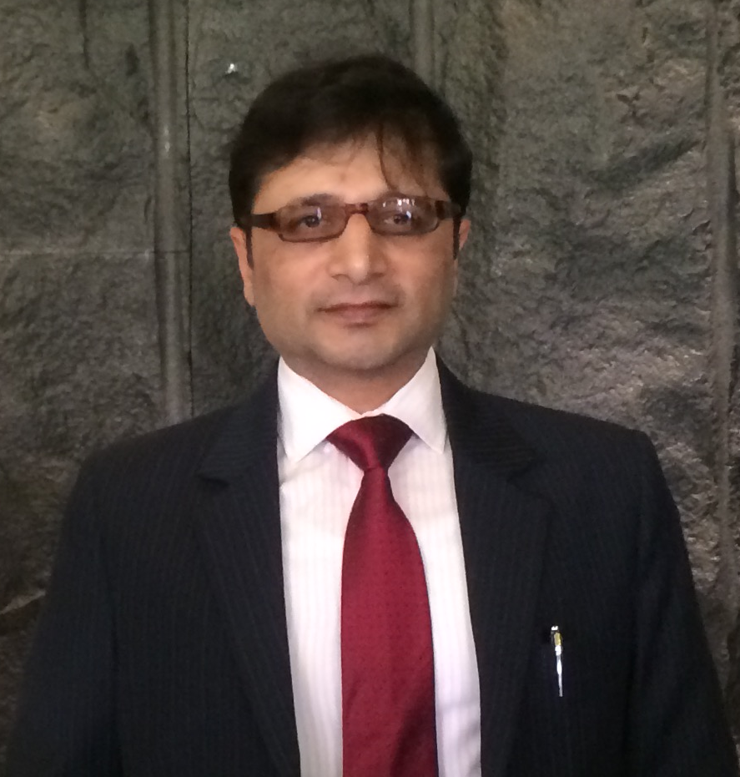
Dr Zafar Zahir, Managing Trustee
Dr. Zafar Zahir comes from the reputed family of Management Guru Dr. M.A. Zahir. Dr.Zafar is the cofounder of Zayn Educational Trust in year 2004 – with an aim to bring professional education – to the grassroots of the Indian society. He currently serves as Managing Director and Honorary Principal at Synetic Business School. He has completed Advanced Corporate Executive Training from Harvard Business School (Executive Education), USA in 2013 and Doctor of Philosophy in Business Management (PhD) – Organisation Development from GND University, Amritsar, India in 1996. He is a MBA in Marketing from Punjab A. University, Ludhiana, India in1991 with OGPA 4/4 and recipient of Lala Shriram Gold Medal and B.Sc degree from Punjab University, Chandigarh in 1989 with 1st Rank in SCD Government College.
Dr. Zafar has over 25 years of corporate and academic experience in different reputed service and manufacturing corporates in India and Middle East. On returning to India in 2016 he has served as Vice Chairman at Trident Ltd., Ludhiana, India. During his almost twenty years career stint in Middle East from 1997 to 2016 he served as Chief Marketing Officer at Maktaba Marketing Company Ltd., Jeddah, Saudi Arabia; in telecom/ICT conglomerate STC Ltd., Riyadh,Saudi Arabia as Director and Senior Advisor; Najdyah Marketing Company, Riyadh, Saudi Arabia as Manager Strategic Marketing. During his PhD he started Profezzional Management Systems at Ludhiana offering management consultancy to the MSMEs’ of Punjab. He began his career after MBA with Vardhman Spinning & General Mills Ltd., Ludhiana,India as Executive – Corporate Projects & Planning.
He has a rich experience in the area of teaching, research and management consultancy both in India and Middle East. Widely travelled across the globe he has participated in various training programs, seminars and exhibitions. In the field of management research he has published a few imperial research papers and authored a book on Organisation Development published by Kalyani Publishers in 1997. His key skills are in domain of Strategic Business Planning, Operational Excellence, OD based Change Management, Leadership, Global Market Development, Human Resource Management, Strategic Partnerships, Learning &Development, Turnaround Management, Brand Building (Employer/Customer), Program Management, etc. He has received various performance awards during his professional career.

Slide 7
Founded in 2004 with
an objective to promote professional education, skill development, health for all especially the under-privileged sections of the society
A Non-Profit Trust registered with GOP and ITI AYOG, Government of India with members from across businesses and professionals of Punjab
Encouraging Meritorious Students especially Female Grads
First Generation Graduate
Financial Assistance
Providing Livelihood Opportunities

Slide 8
Dr Zahir* conferred with LMA Satya Pal Mittal Award Life Time Achievement Award of the Year
03-Dec-18
Dr. Zafar** receiving the Life Time Achievement Award for his Father Lt. Dr.M.A. Zahir
*Dr Zahir has been awarded two other Life Time Achievement Awards from PCMA and MTMI USA in 2009
**Dr Zafar is an MBA, PhD with meritorious career history in management consulting, manufacturing and services in various countries

Slide 9
Professional Education
Community Health Care
Health Awareness Camps
Female Hygiene and Health Workshops
NSS Camps in Industrial settlement and Rural Areas.
Purpose based technical education Supporting the underprivileged students Creating “First Generation Graduates” Providing gainful employment – placement or entrepreneurship
AREA OF OPERATIONS

Slide 10
ZAYN TRUST RUNS A BUSINESS SCHOOL IN LUDHIANA
Regular Degree Programs affiliated to IKGPTU, Jalandhar
MCOM
BCOM
BCA
BBA
JOB ORIENTED SKILL DEVELOPMENT TRAINING
(ISO CERTIFIED BY UASL, UNITED KINGDOM)
Management
Account & Finance
Digital Marketing/ eCommerce
Computer Applications & IT
Mobile App development
Hardware and Networking
Personality Development
Fashion Designing & Technology

Slide 11
Spacious campus spread over 6.5 acres combines the best of architecture, aesthetics and functionality
Dedicated campus with focus on business management, commerce and IT education Amphitheatre and large playgrounds
State-of-the-art computer lab with broadband connection Air-conditioned stair type class rooms
Latest teaching aids such as LCD, Projector, laptops, OHP Auditorium for Functions and Events
Library with Books and Recent Journals/Mags
ZET CAMPUS

Slide 12
Every year ZET organizes various activities in its SBS Campus such as UMEED (Job Fair), Parwaaz (Annual Function), Quwat (Sports Day), Alvida (Farewell Party) and various scholarship tests.
LIFE AT SBS

Slide 13
Encouraging Meritocracy, Employment Opportunity and helping
Deserving Students who cannot afford Higher Education
Encouraging Maritorious Students
Financial Assistants for Underpriviledged Students
Providing Placement Platform

Slide 14
FOSTERING MERITOCRACY IN STUDENTS FROM HUMBLE BACKGROUND
Special focus on female students empowerment
SBS Female Students regularly top in University Exams complementing the national mission of "Beti Bachao-Beti Padao"

Slide 15
Financial Assistance to Under-Privileged Students
SBS is working relentlessly to produce "First Generation Graduates" in many families where children have not been educated beyond school due to occupational, social & economic issues.
Fathers of some students are working as vegetable hawkers, daily wagers, tiny business owners, while some students are orphans and self-employed

Slide 16
What Students Say about Us
Deepika B.COM Final
Lata Pandey B.COM Final
Balkaran Kaur B.COM Final
My parents were not in position to continue my study because of low Income level, then I visit SBS Campus with my parents and told them all
problems, then they immediately give me admission on freeship.
Thanks SBS!
It was not possible to continue my study without the help of Trust.
The SBS is so humble specially for girl students. SBS is
providing education to poor students every year whose family income low than Rs 1 lac in a year. I am feeling proud to became the part of SBS
My dream was not possible to complete without the help of SBS College.
It supported me and made me capable for the day where I bagged the top ten positions in the university merit

Slide 17
PROVIDING PLACEMENT PLATFORM
Conducting UMEED Job Fair every year to facilitate industries to find talent
SBS conducts Umeed Job Fair every year since 2010. More than 600 students from various degree and engineering colleges from across Ludhiana registered at Umeed 2019.
2019 Umeed was another grand success
Over 150 students got pre-placement appointment letters
Success continued, where over 1000 students participated
BBA/BCA/B.Com students get placed with IT, Service & Mfg. Cos.

Slide 18
Community Service Initiatives
ORGANISED MORE THAN 100 FREE MEDICAL CAMP
CONDUCTED OVER 50 FEMALE HEALTH AWARENESS WORKSHOPS in Schools, Gurudwara, Community Centers, Industrial Areas, ..

Slide 19
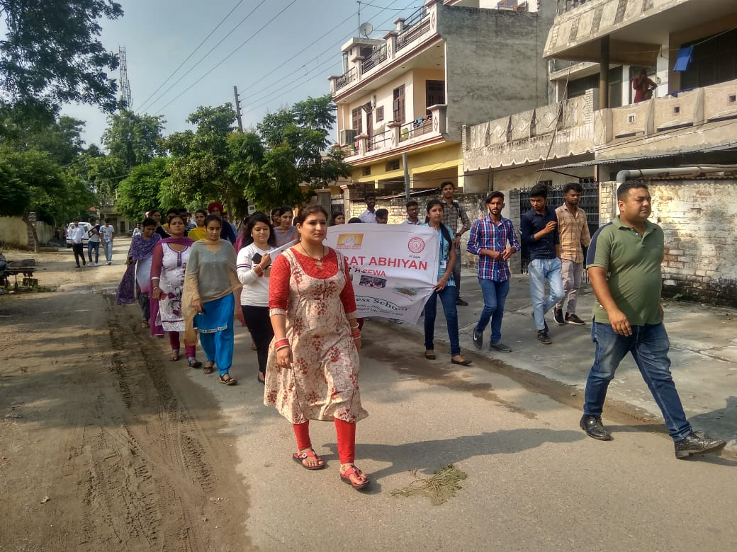
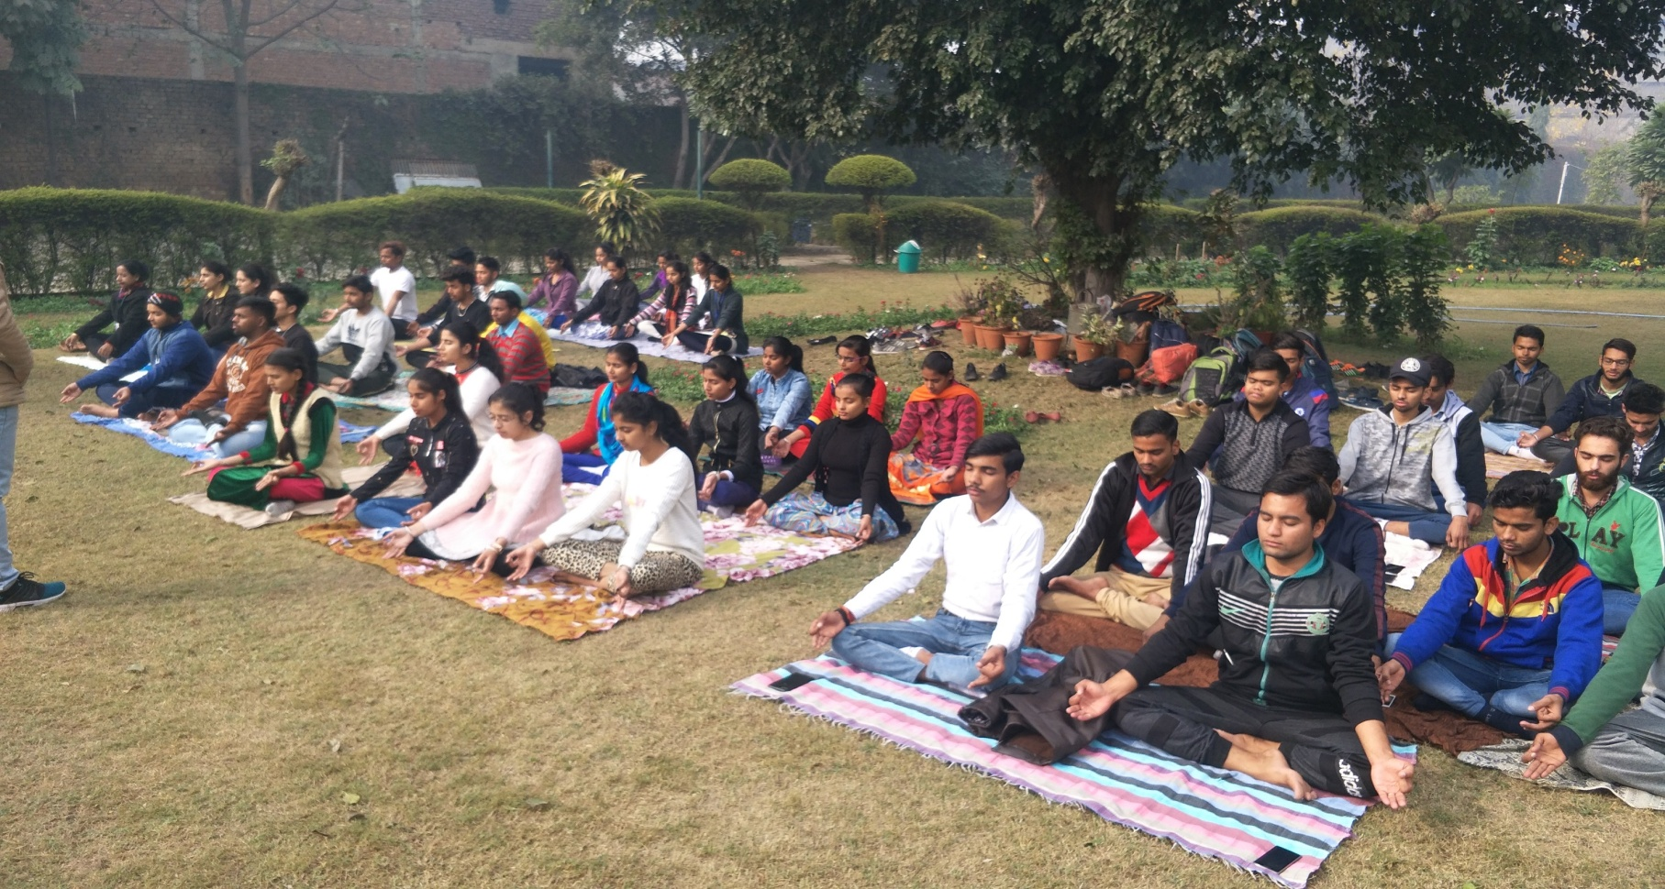
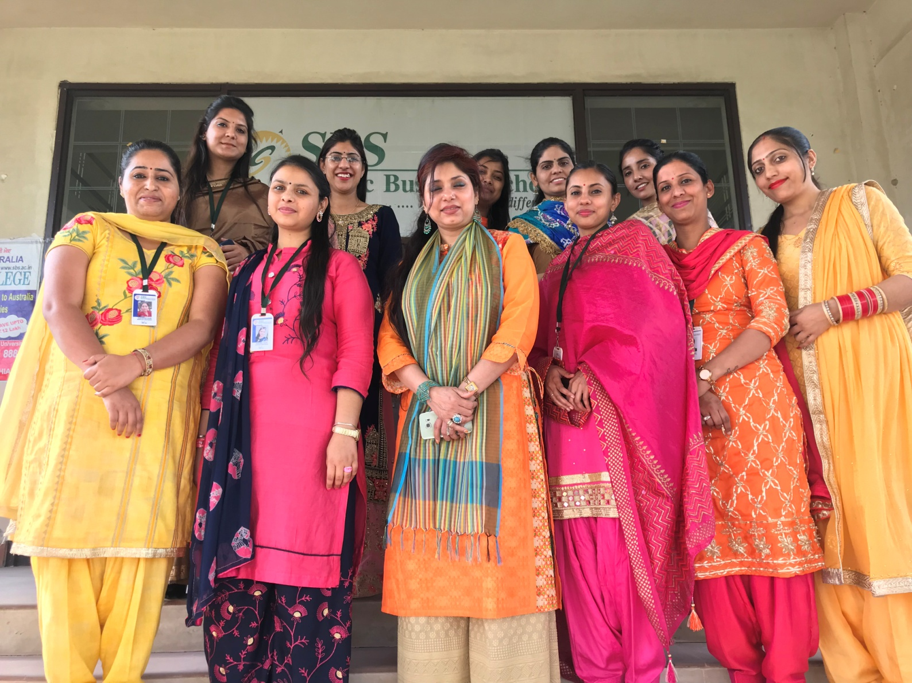
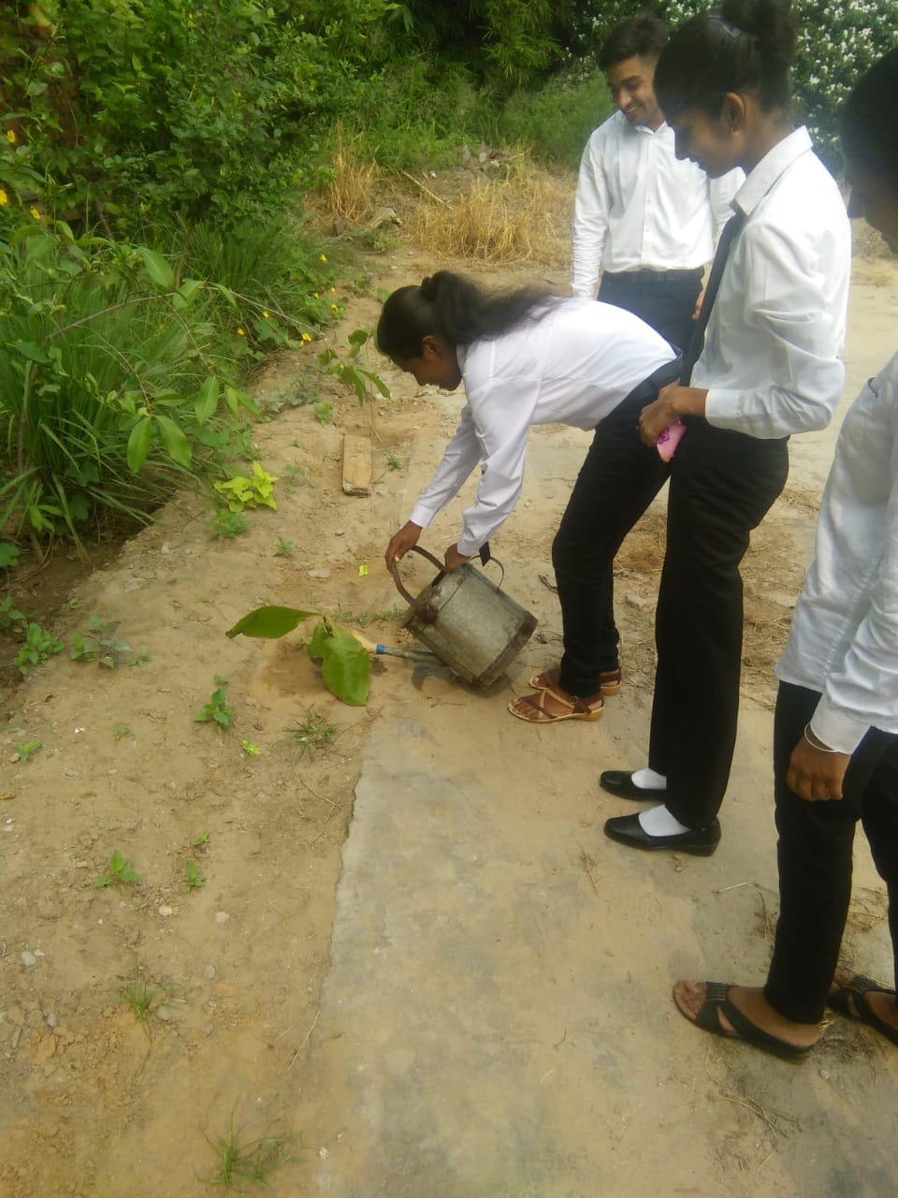
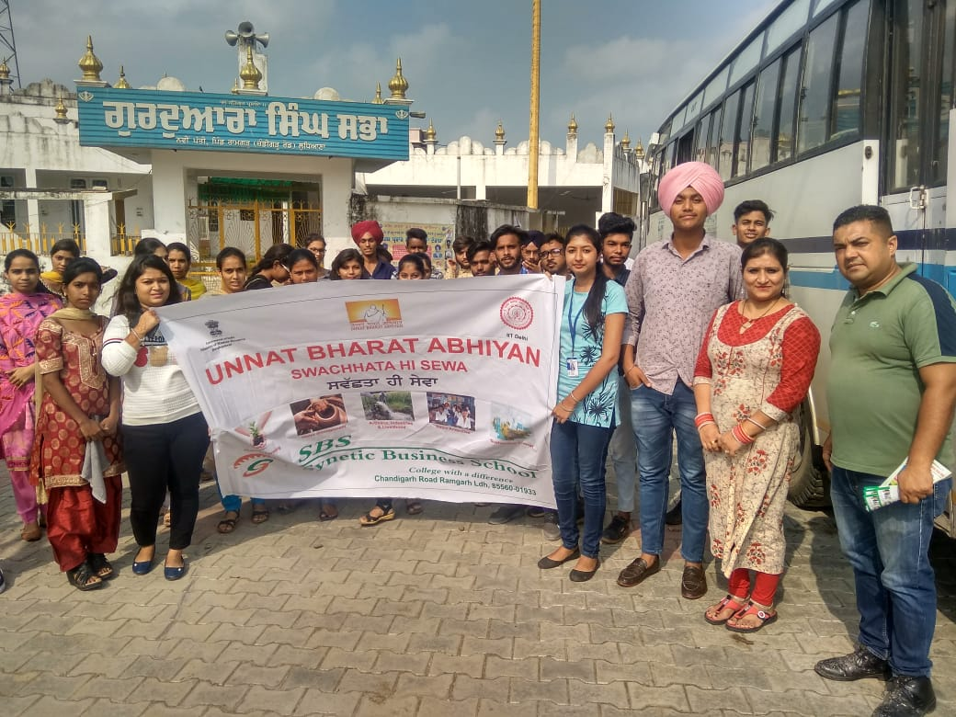
Proud Sponsor of NSS Activities & Unnat Bharat Abhiyaan under GOI, HRD/IITD
Cleanliness & NSS Camps
NEEDS-MEANS SCHOLARSHIP
FUNDING FEES OF >100STDS
CLEANLINESS, SOCIAL AWARENESS, COMMUNITY SERVICE, RURAL DEVELOPMENT

Slide 20
SPONSOR STUDENT DEGREE PROGRAM
Help us in our journey of creating “First Generation Graduates” by part or full funding of their degree – Cost per student is Rs 136,500 for three year for 100% Freeship.
You can track the student performance and select the most deserving students.
FUND INFRASTRUCTURE SUPPORT
Support us in upgrading our infrastructure – Library and Classrooms Help us in building a modern Computer Lab and Smart Class rooms Assist us with soft grant or donations for expansion of infrastructure
Patronise Us
PLACEMENT/SKILL DEVELOPMENT/ INTERNSHIP
Recruit from SBS directly for your business - office, factory, etc.
Place students as interns for summer jobs, Offer On-the-Job assistance or Co-ops
Provide livelihood training and skill enhancement/development to youth, widows, rural women, educated unemployed, etc.
COMMUNITY SERVICE
Sponsor our Health Camps and Community service drives to reach more villages, industrial labour camps and underprivileged civic areas

Slide 21
Spending for the cause of Educating the Youth is an Enabler for
their future bright and
Sustainable
Nation Building
Contact Us:
Address:
Phone No.
+91-9815188836
Email ID:
principal@sbs.ac.in
Ramgarh Chandigarh Road,
Ludhiana -141123, India
www.sbs.ac.in
https://www.linkedin.com/company/zayntrust/
https://www.instagram.com/zayntrust01/
https://www.sbs.ac.in/zayntrust/

